Slide 1
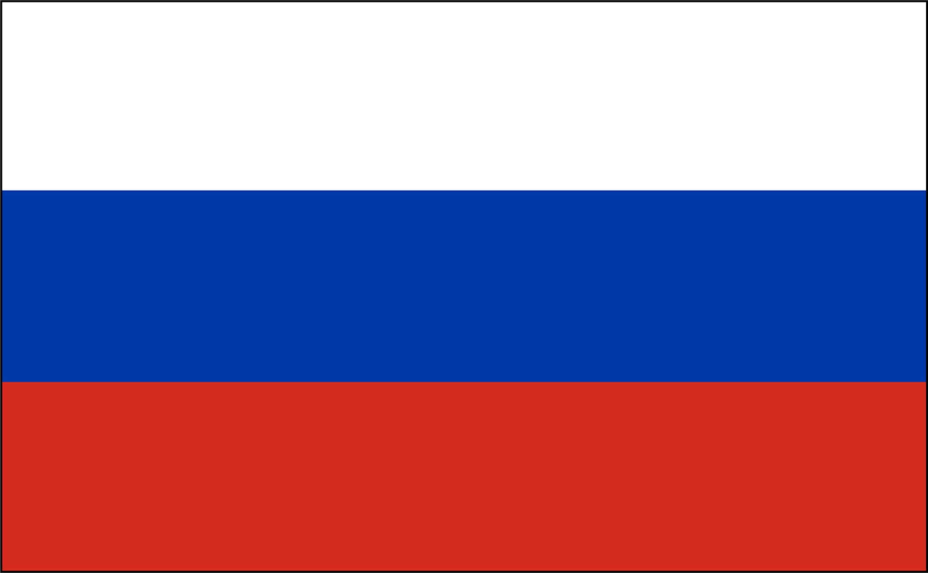
Bingo Quiz Countries
code-14-001

Slide 2
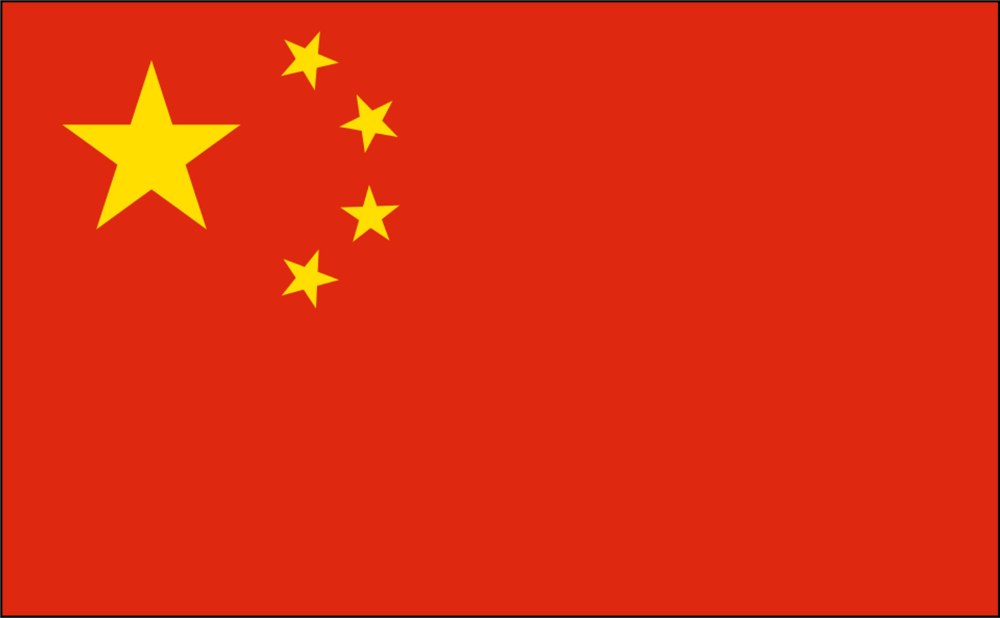
Notes:
Ni-Hao
(Ni-Hao-Maa) polite version

Slide 3
Notes:
Bongiorno
Emphasize on the “gio”

Slide 4
Notes:
Hej!
(the “!” is important)

Slide 5
Notes:
kon-nichi-ha

Slide 6
Notes:
Ola (familiar)

Slide 7
Notes:
Priviet
The “r” is between the “r” and the “l” sound
The “v” is between the “v” and the “b” sound

Slide 8
Notes:
Hi!

Slide 9
Notes:
Sain uu
(ask a mongol, I don’t know the right pronunciation)

Slide 10
Notes:
Assallahm alleyKum

Slide 11
Notes:
Good Morning Sir!

Slide 12
Notes:
Buenos Dias

Slide 13
Notes:
Bonjour

Slide 14
Notes:
Hola
(the “h” sound is important, like the Japanese”ho”)

