Slide 1
France

Slide 2
France
in
You can see_____
You can buy_____
You can eat______

Slide 4
You can see ____ _
The Eiffel Tower

Slide 5
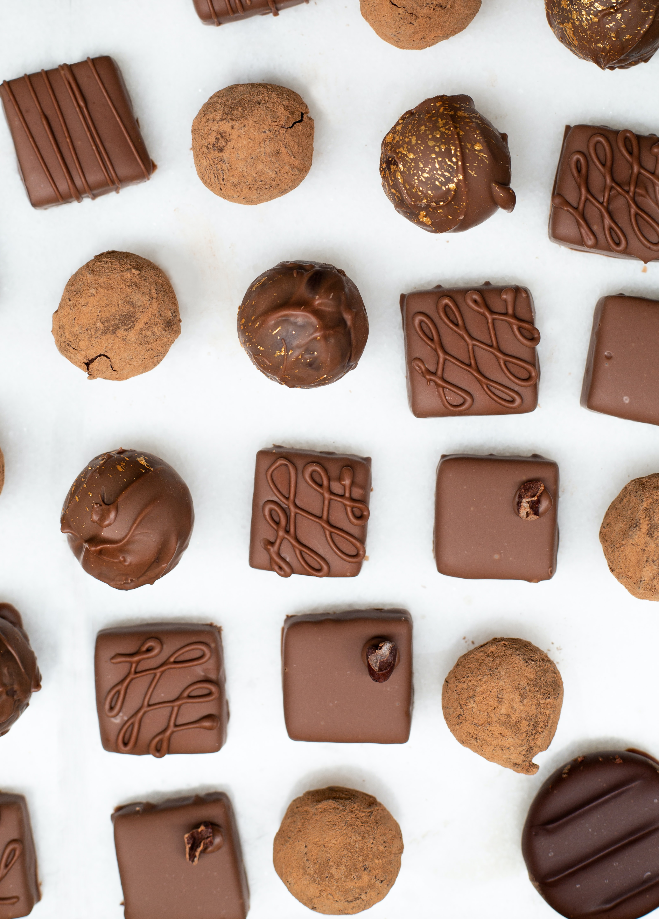
You can buy ____ _
Chocolate

Slide 6
You can eat _____
Cheese

