Slide 1
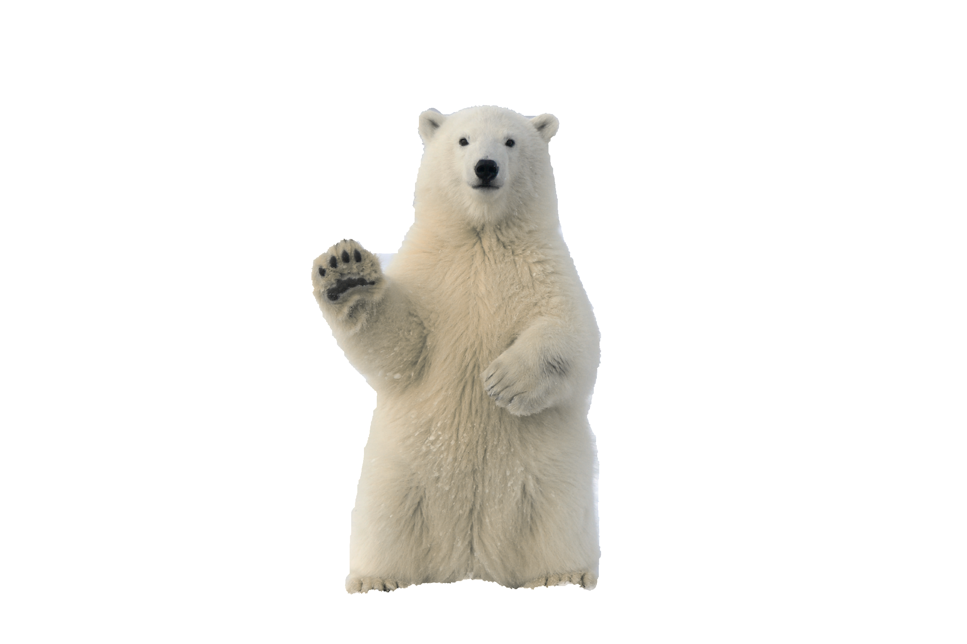
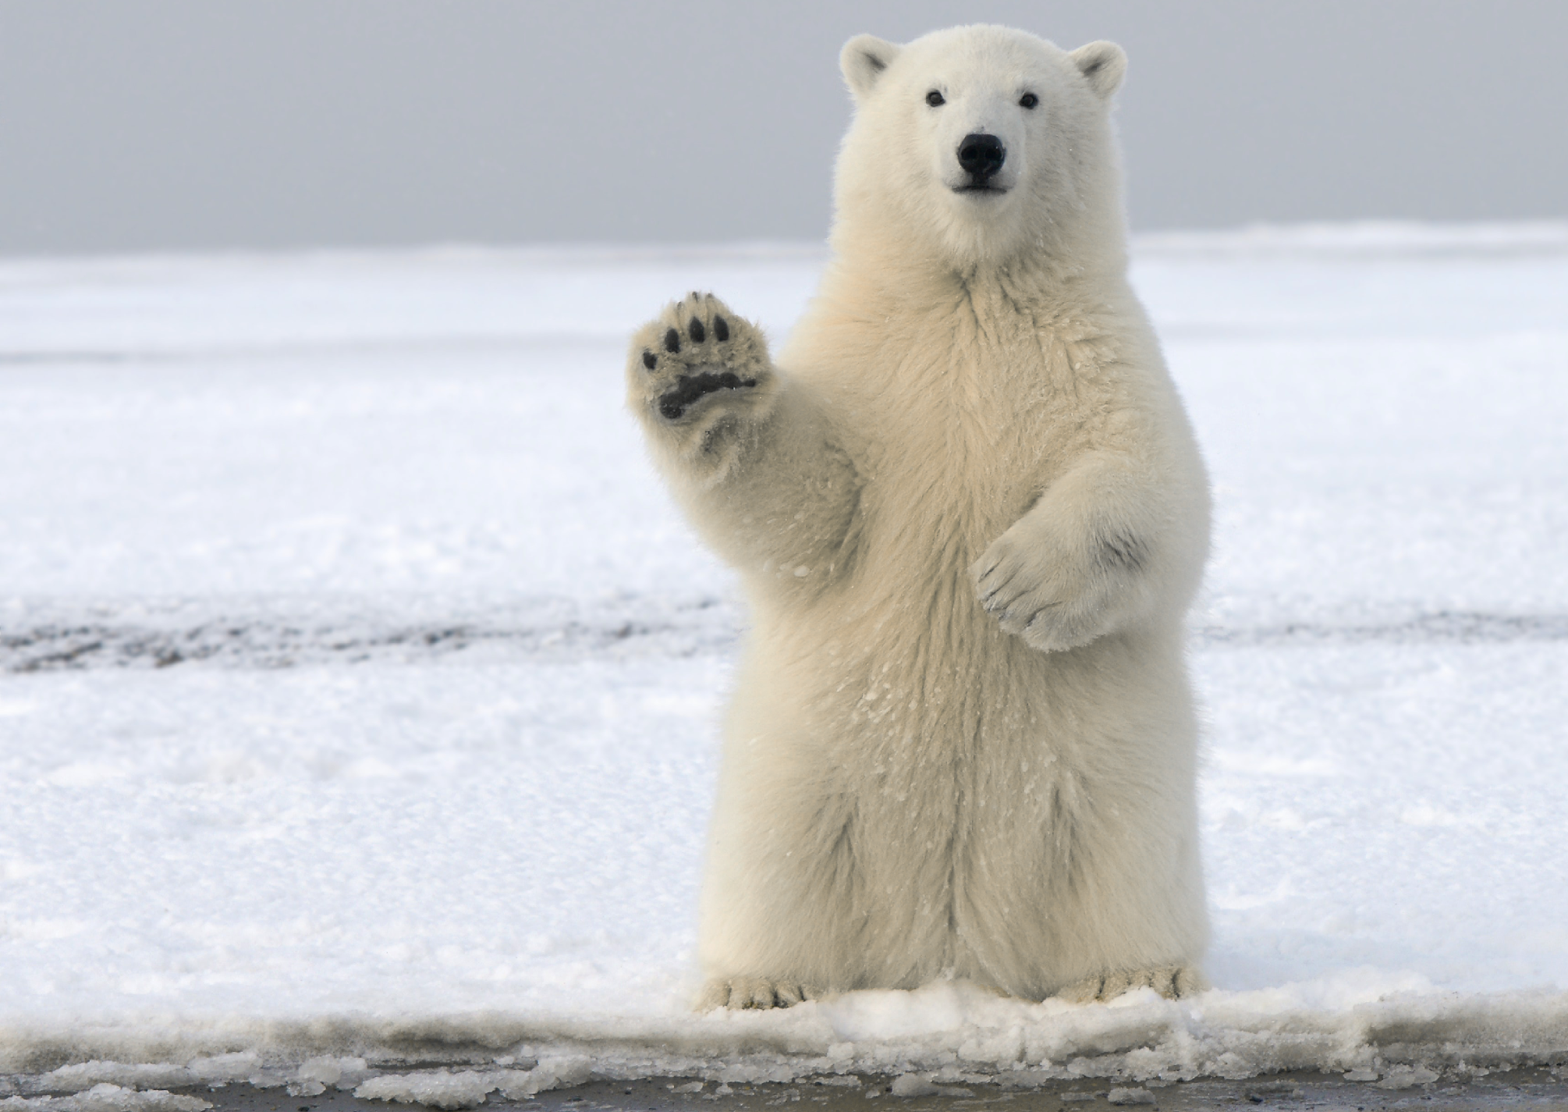
Where do polar bears live?
polar bears live
in the arctic

Slide 2
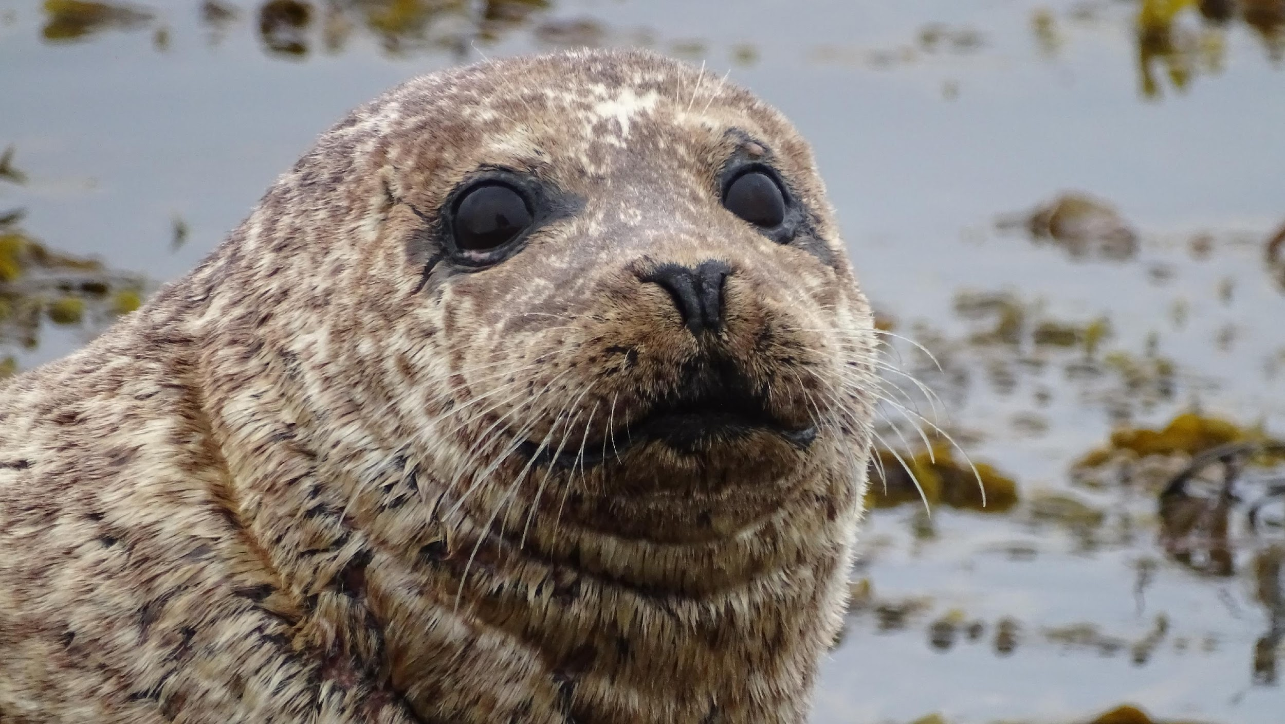

What do polar bears eat?
polar bears eat
seals

Slide 3
polar bears can
swim fast!
Hint!
…………….

Slide 4
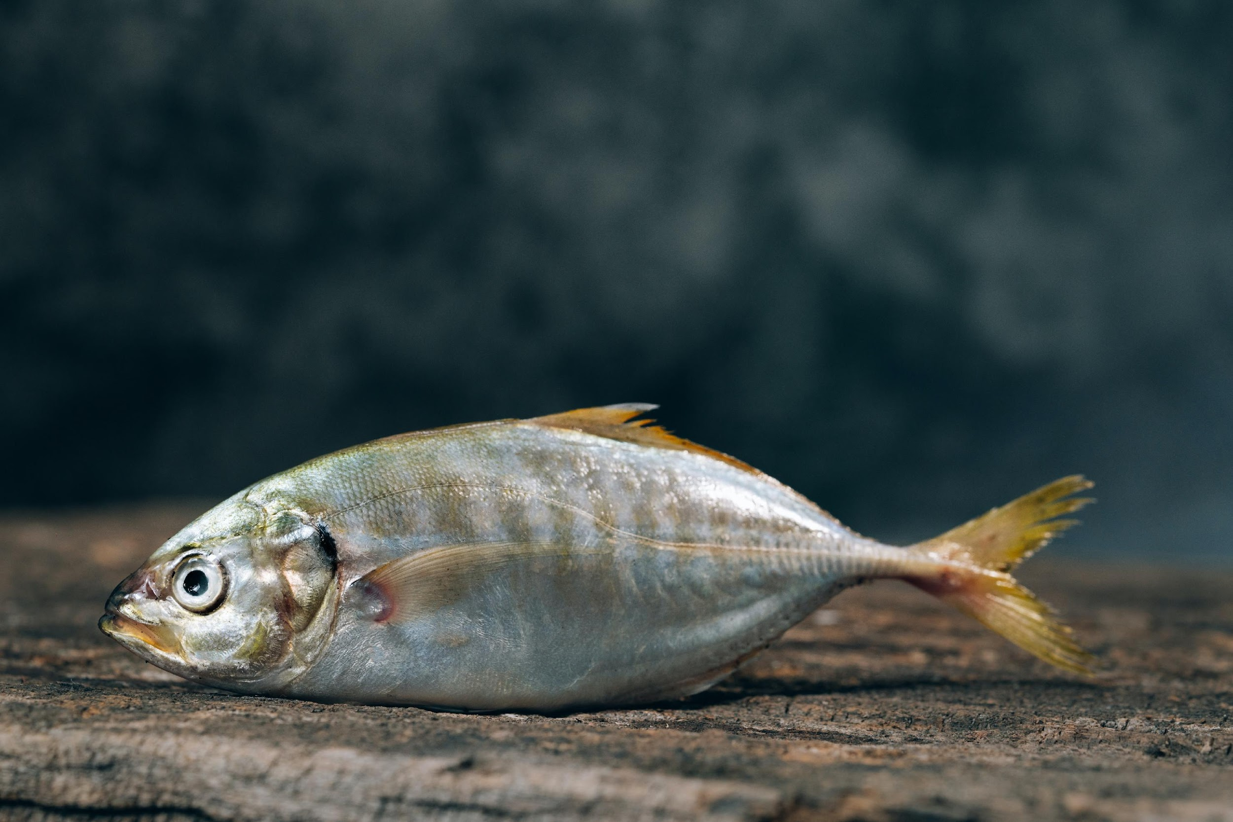
Seals eat
fish

Slide 5
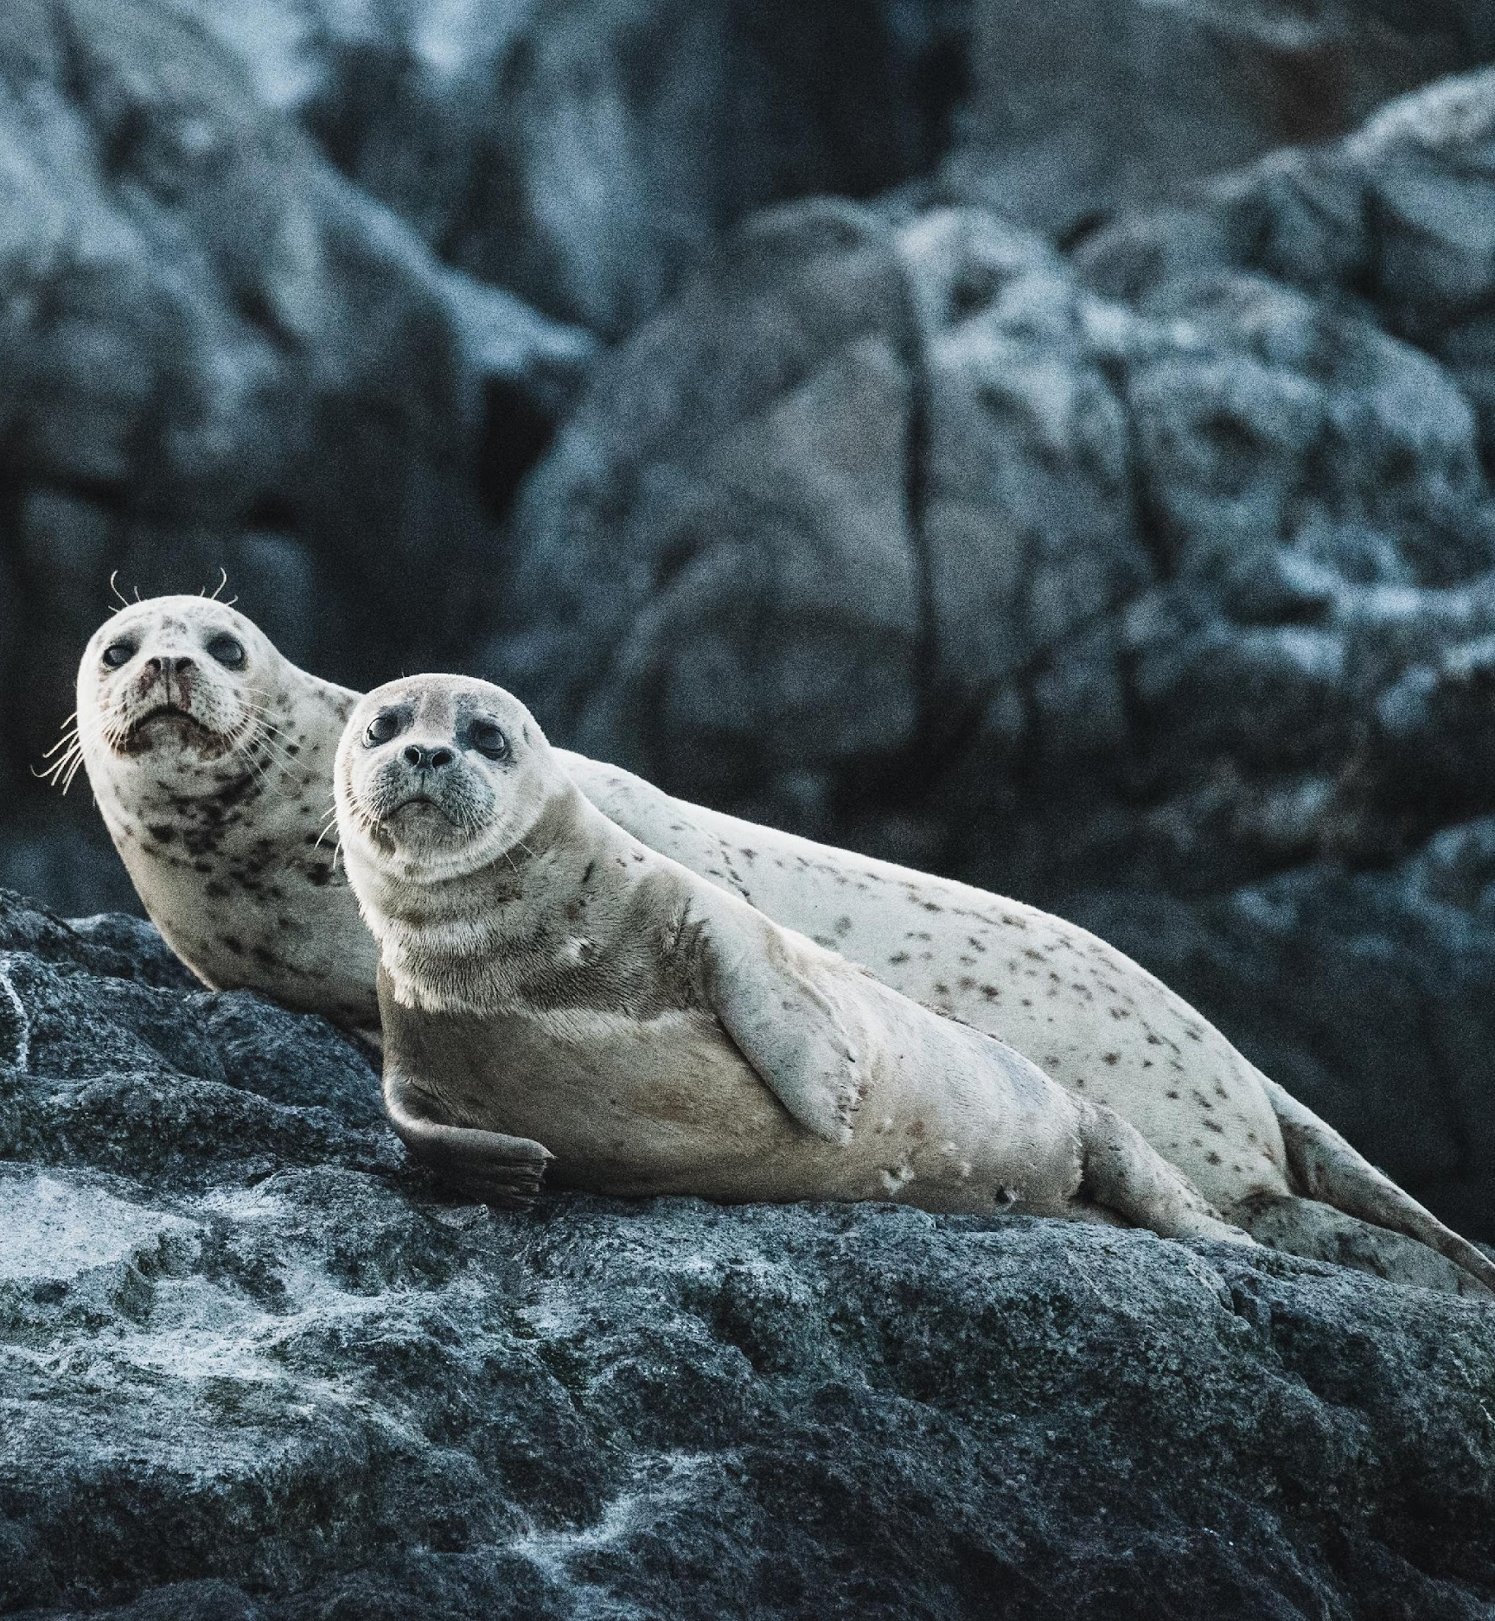
Seals are
cute

Slide 6
Where do polar bears live?
Polar bears live
in the arctic
What do polar bears eat?
Polar bears eat
seals
Polar bears can swim fast

Slide 7
Where do polar bears live?
Polar bears live
in the arctic
Seals eat fish
Seals are cute
What do polar bears eat?
Polar bears eat
seals
Polar bears can swim fast

Slide 8
1
Where do polar bears live?
2
Polar bears live
in the arctic
3
What do polar bears eat?
4
Polar bears eat
seals
+
Polar bears can swim fast
4
Seals eat fish
+
Seals are cute

Slide 9
1
live
2
食べ物
3
+
4
4

Slide 10
1
2
食べ物
3
+
4
4

Slide 11
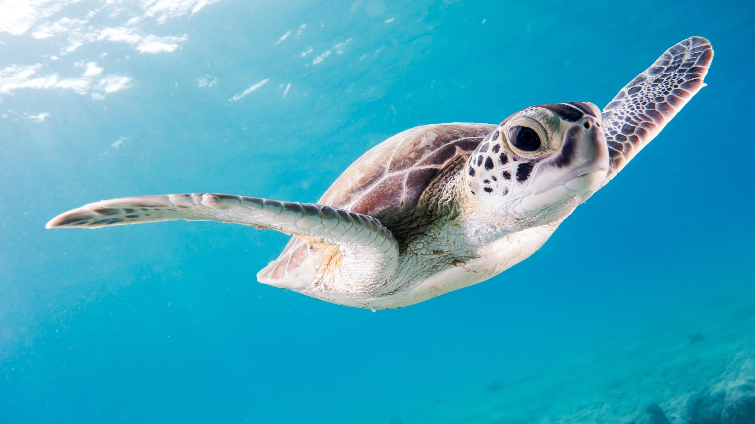
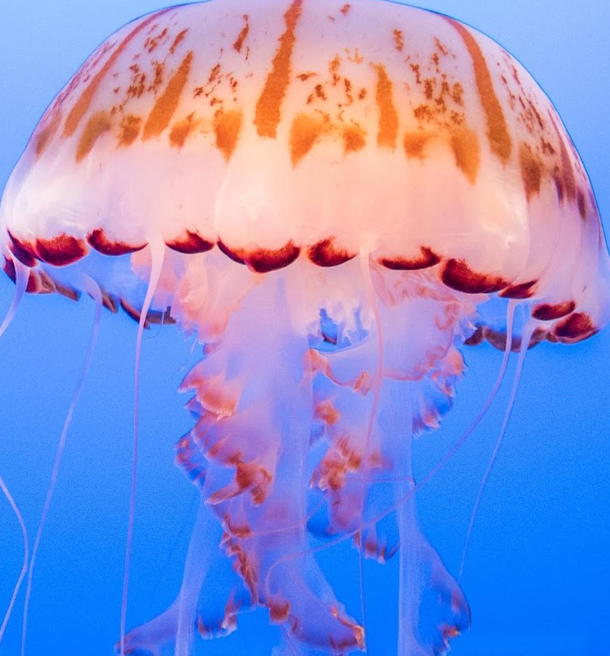
1
2
食べ物
3
+
4
4

Slide 12
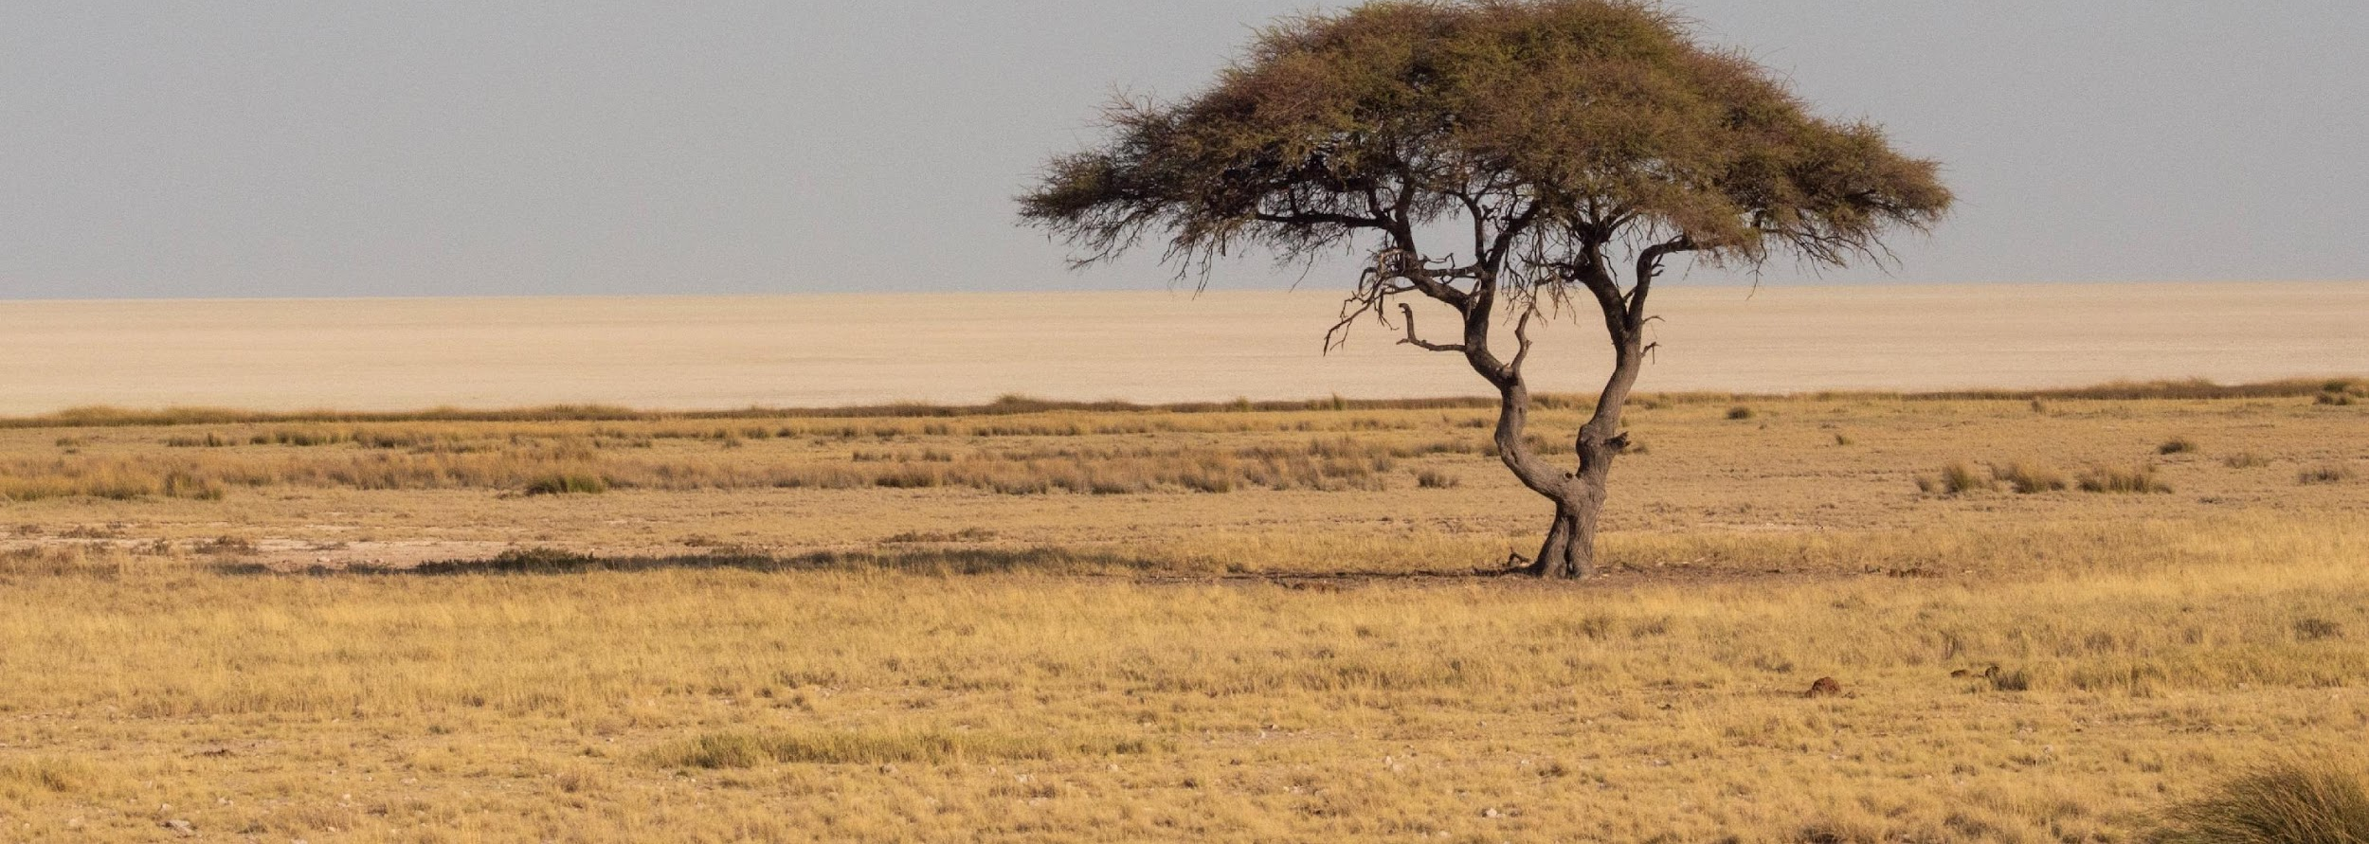
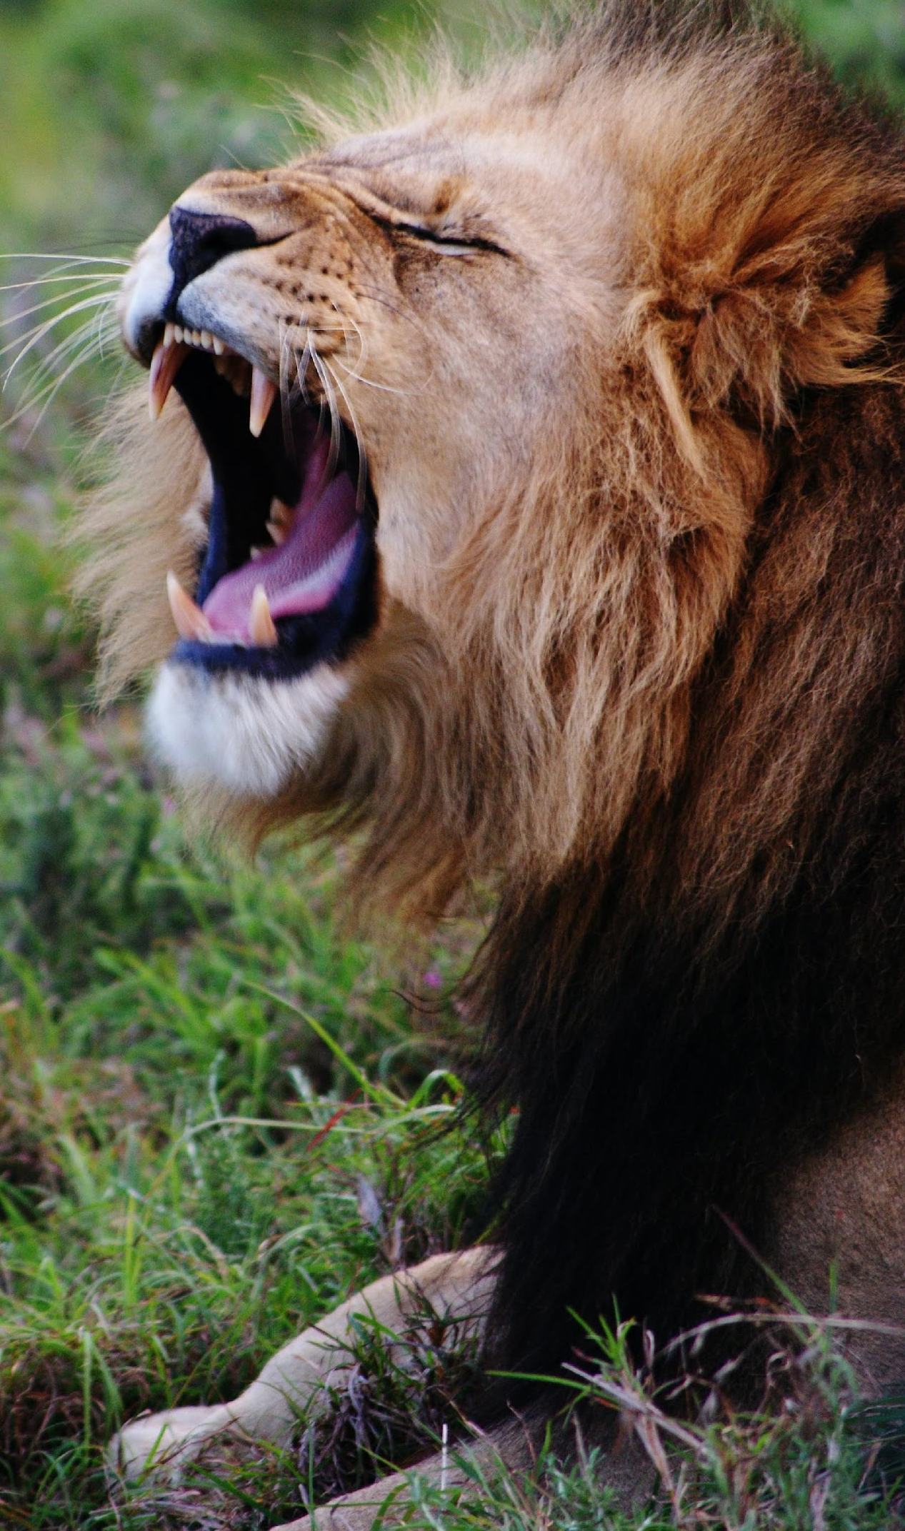
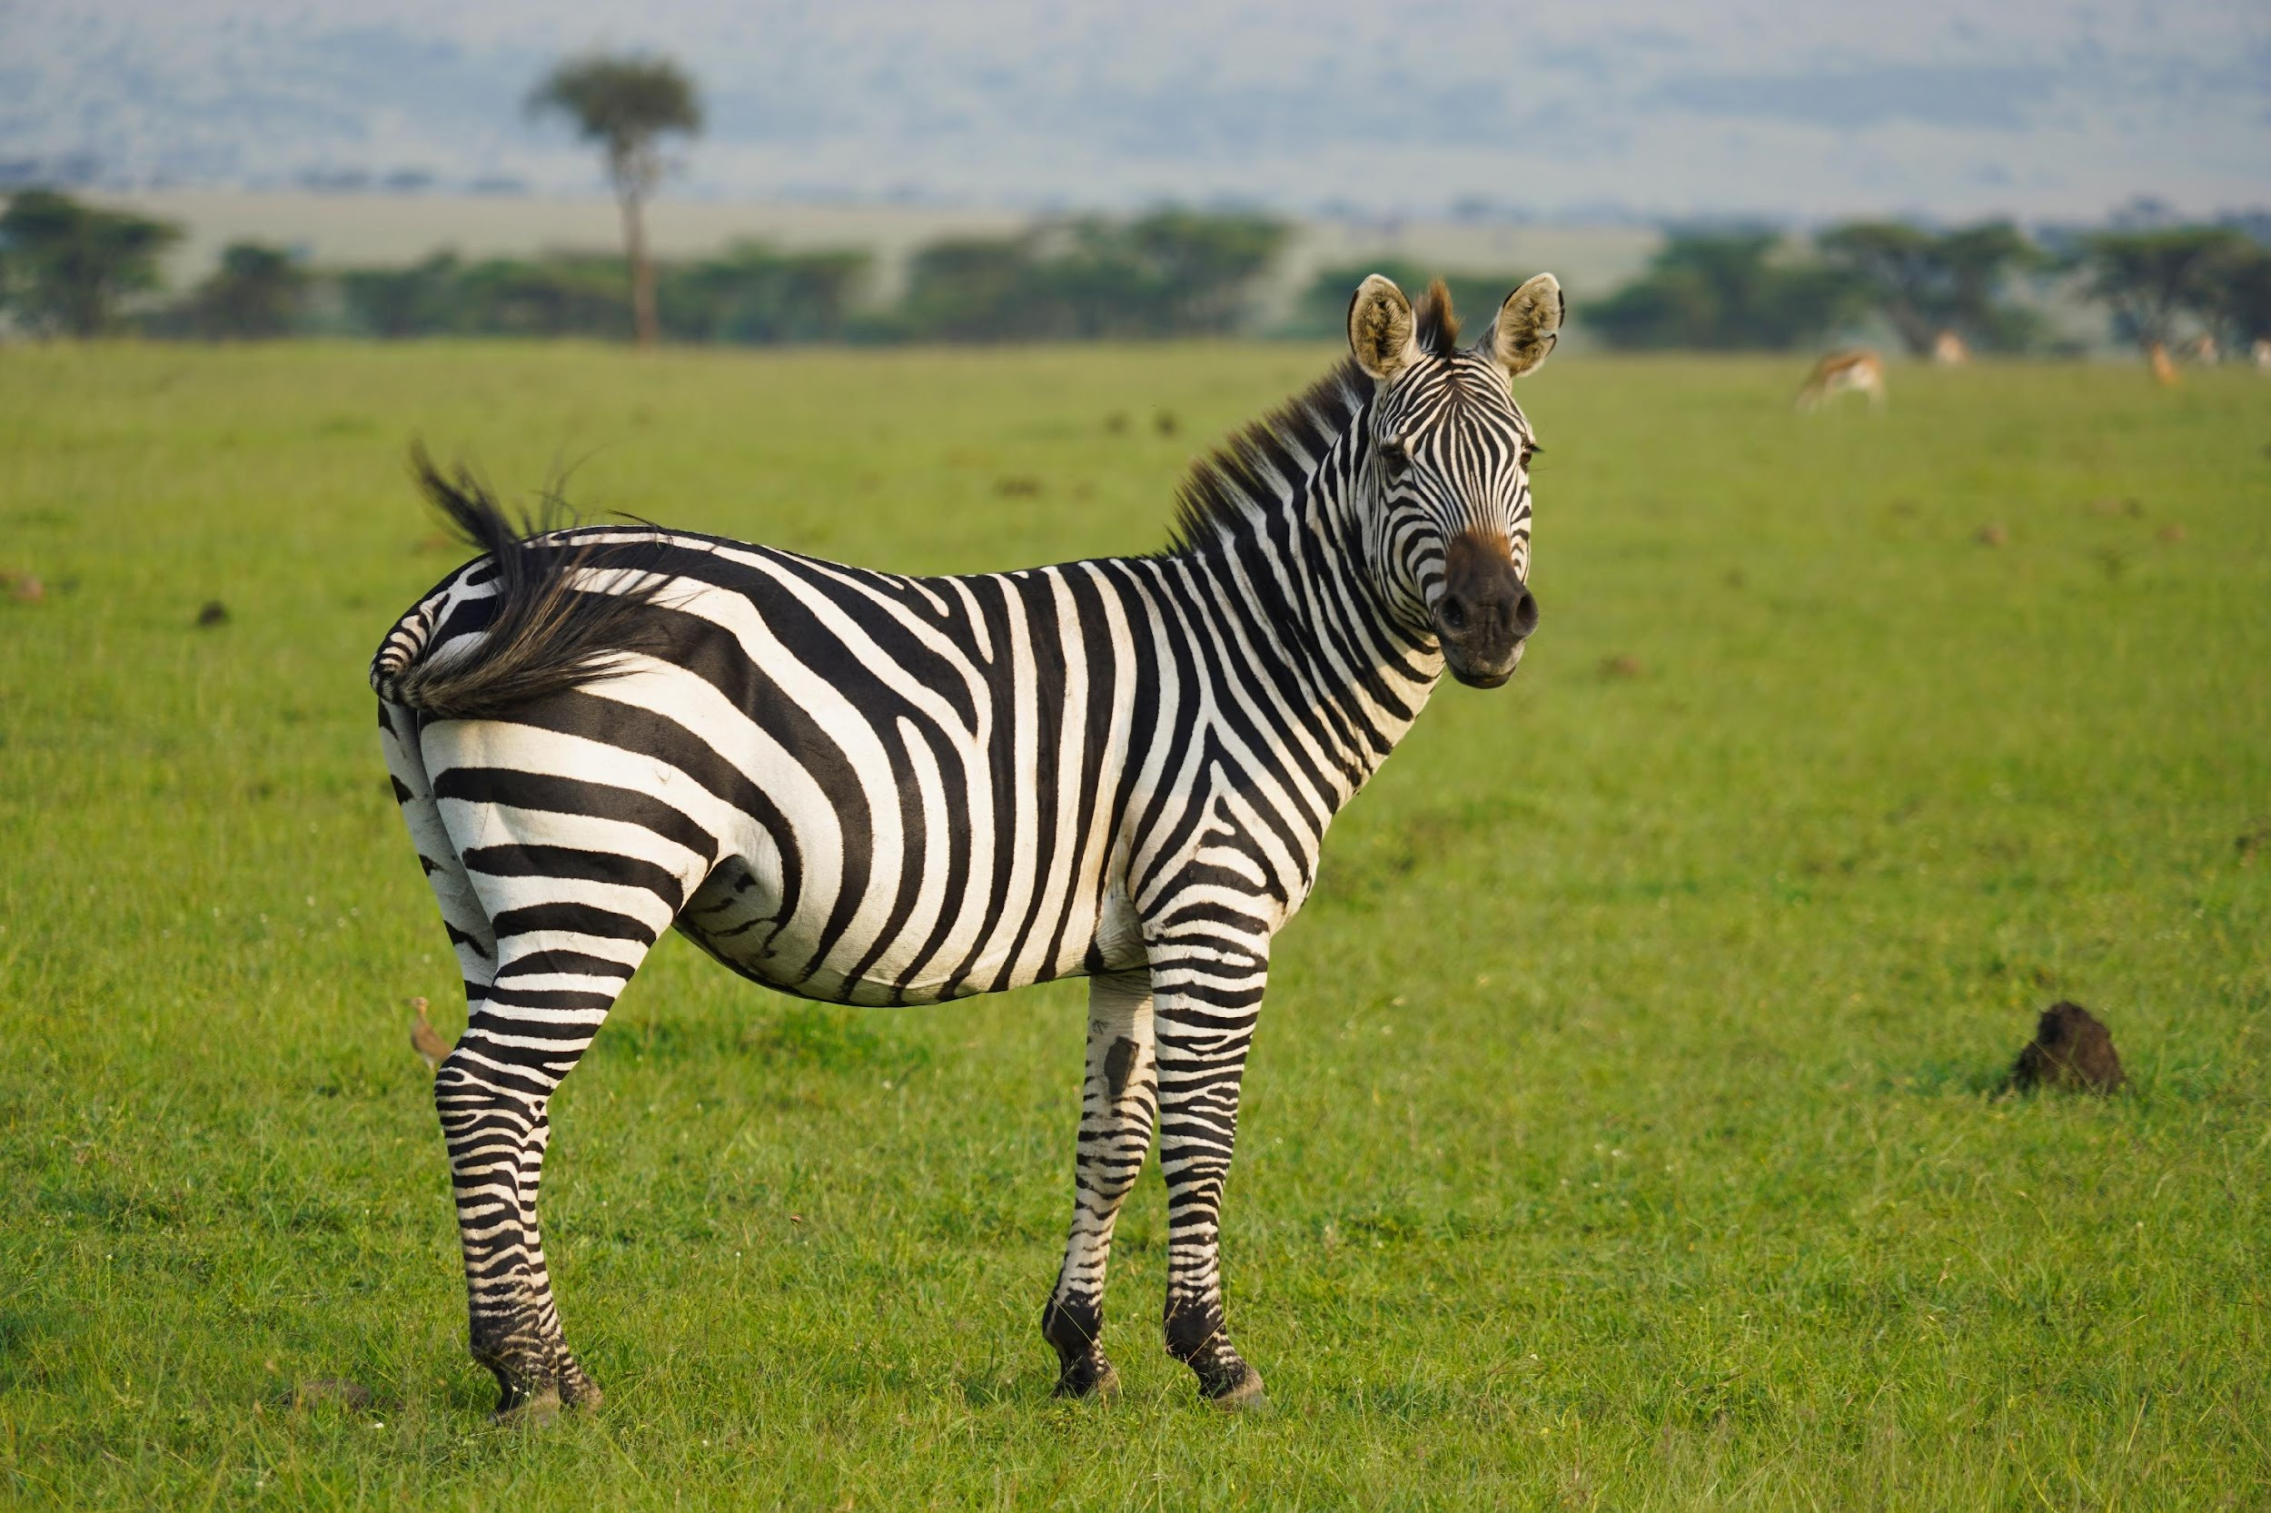
1
2
食べ物
3
+
4
4

